Slide 1
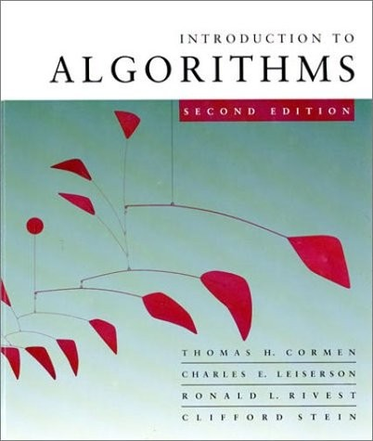

LECTURE 6
Greedy Algorithms (and Graphs)
Graph representation
Minimum spanning trees
Optimal substructure
Greedy choice
Prim’s greedy MST algorithm
Dr. Yeshwant Singh

Slide 2
Graphs (review)
Definition. A directed graph (digraph)
G = (V, E) is an ordered pair consisting of
a set V of vertices (singular: vertex),
a set E ⊆ V × V of edges.
In an undirected graph G = (V, E), the edge set E consists of unordered pairs of vertices.
In either case, we have | E | = O(V ²). Moreover, if G is connected, then | E | ≥ | V | – 1, which implies that lg | E | = Θ(lg V).
(Review CLRS, Appendix B.)

Slide 3
Adjacency-matrix representation
The adjacency matrix of a graph G = (V, E), where V = {1, 2, …, n}, is the matrix A[1 . . n, 1 . . n] given by
1 if (i, j) ∈ E,
A[i, j] =
0 if (i, j) ∉ E.

Slide 4





Adjacency-matrix representation
The adjacency matrix of a graph G = (V, E), where V = {1, 2, …, n}, is the matrix A[1 . . n, 1 . . n] given by
1 if (i, j) ∈ E,
A[i, j] =
0 if (i, j) ∉ E.
A |  |  | 1 | 2 | 3 | 4
2 | 1 | 1 | 0 | 1 | 1 | 0
 |  | 2 | 0 | 0 | 1 | 0
3 | 4 | 3 | 0 | 0 | 0 | 0
 |  | 4 | 0 | 0 | 1 | 0
Θ(V ²) storage
⇒ dense
representation.

Slide 5


Adjacency-list representation
An adjacency list of a vertex v ∈ V is the list Adj[v] of vertices adjacent to v.
2 1
3 4
Adj[1] = {2, 3}
Adj[2] = {3}
Adj[3] = {}
Adj[4] = {3}

Slide 6
Adjacency-list representation
An adjacency list of a vertex v ∈ V is the list Adj[v] of vertices adjacent to v.
2 1
3 4
Adj[1] = {2, 3}
Adj[2] = {3}
Adj[3] = {}
Adj[4] = {3}
For undirected graphs, | Adj[v] | = degree(v). For digraphs, | Adj[v] | = out-degree(v).

Slide 7
Adjacency-list representation
An adjacency list of a vertex v ∈ V is the list Adj[v] of vertices adjacent to v.
2 1
3 4
Adj[1] = {2, 3}
Adj[2] = {3}
Adj[3] = {}
Adj[4] = {3}
For undirected graphs, | Adj[v] | = degree(v). For digraphs, | Adj[v] | = out-degree(v).
Handshaking Lemma: ∑_{v∈V} degree(v) = 2 | E | for undirected graphs ⇒ adjacency lists use Θ(V + E) storage — a sparse representation.

Slide 8
Minimum spanning trees
Input: A connected, undirected graph G = (V, E) with weight function w : E → R.
For simplicity, assume that all edge weights are distinct. (CLRS covers the general case.)

Slide 9
Minimum spanning trees
Input: A connected, undirected graph G = (V, E) with weight function w : E → R.
For simplicity, assume that all edge weights are distinct. (CLRS covers the general case.)
Output: A spanning tree T — a tree that connects all vertices — of minimum weight:
w(T ) = ∑ w(u, v) .
(u,v)∈T

Slide 10




Example of MST
6 12
5
9
14
7
8
15
3
10

Slide 11
Example of MST
6 12
5
9
14
7
8
15
3
10

Slide 12
Optimal substructure
MST T:
(Other edges of G
are not shown.)

Slide 13
Optimal substructure
MST T:
(Other edges of G
are not shown.)
u
v
Remove any edge (u, v) ∈ T.

Slide 14
Optimal substructure
MST T:
(Other edges of G
are not shown.)
u
v
Remove any edge (u, v) ∈ T.

Slide 15
Optimal substructure
MST T:
(Other edges of G
are not shown.)
u
T
2
v
T
1
Remove any edge (u, v) ∈ T. Then, T is partitioned into two subtrees T₁ and T₂.

Slide 16
Optimal substructure
MST T:
(Other edges of G
are not shown.)
u
T
2
v
T
1
Remove any edge (u, v) ∈ T. Then, T is partitioned into two subtrees T₁ and T₂.
Theorem. The subtree T₁ is an MST of G₁ = (V₁, E₁), the subgraph of G induced by the vertices of T₁:
V₁ = vertices of T₁,
E₁ = { (x, y) ∈ E : x, y ∈ V₁ }.
Similarly for T₂.

Slide 17
Proof of optimal substructure
Proof. Cut and paste:
w(T) = w(u, v) + w(T₁) + w(T₂).
If T₁′ were a lower-weight spanning tree than T₁ for
G₁, then T ′ = {(u, v)} ∪ T₁′ ∪ T₂ would be a lower-weight spanning tree than T for G.

Slide 18
Proof of optimal substructure
Proof. Cut and paste:
w(T) = w(u, v) + w(T₁) + w(T₂).
If T₁′ were a lower-weight spanning tree than T₁ for
G₁, then T ′ = {(u, v)} ∪ T₁′ ∪ T₂ would be a lower-weight spanning tree than T for G.
Do we also have overlapping subproblems?
Yes.

Slide 19
Proof of optimal substructure
Proof. Cut and paste:
w(T) = w(u, v) + w(T₁) + w(T₂).
If T₁′ were a lower-weight spanning tree than T₁ for
G₁, then T ′ = {(u, v)} ∪ T₁′ ∪ T₂ would be a lower-weight spanning tree than T for G.
Do we also have overlapping subproblems?
Yes.
Great, then dynamic programming may work!
Yes, but MST exhibits another powerful property which leads to an even more efficient algorithm.

Slide 20

Hallmark for “greedy” algorithms
Greedy-choice property A locally optimal choice is globally optimal.

Slide 21
Hallmark for “greedy” algorithms
Greedy-choice property A locally optimal choice is globally optimal.
Theorem. Let T be the MST of G = (V, E), and let A ⊆ V. Suppose that (u, v) ∈ E is the least-weight edge connecting A to V – A. Then, (u, v) ∈ T.

Slide 22








Proof of theorem
Proof. Suppose (u, v) ∉ T. Cut and paste.
T: v
u
∈ A
∈ V – A
(u, v) = least-weight edge connecting A to V – A

Slide 23
Proof of theorem
Proof. Suppose (u, v) ∉ T. Cut and paste.
T: v
u
∈ A
∈ V – A
(u, v) = least-weight edge connecting A to V – A
Consider the unique simple path from u to v in T.

Slide 24
Proof of theorem
Proof. Suppose (u, v) ∉ T. Cut and paste.
T: v
u
∈ A
∈ V – A
(u, v) = least-weight edge connecting A to V – A
Consider the unique simple path from u to v in T.
Swap (u, v) with the first edge on this path that connects a vertex in A to a vertex in V – A.

Slide 25
Proof of theorem
Proof. Suppose (u, v) ∉ T. Cut and paste.
T ′: v
∈ A
u
(u, v) = least-weight edge connecting A to V – A
∈ V – A
Consider the unique simple path from u to v in T.
Swap (u, v) with the first edge on this path that connects a vertex in A to a vertex in V – A.
A lighter-weight spanning tree than T results.

Slide 26
Prim’s algorithm
IDEA: Maintain V – A as a priority queue Q. Key each vertex in Q with the weight of the least- weight edge connecting it to a vertex in A.
Q ← V
key[v] ← ∞ for all v ∈ V
key[s] ← 0 for some arbitrary s ∈ V
while Q ≠ ∅
do u ← EXTRACT-MIN(Q)
for each v ∈ Adj[u]
do if v ∈ Q and w(u, v) < key[v]
then key[v] ← w(u, v)
π[v] ← u
⊳ DECREASE-KEY
At the end, {(v, π[v])} forms the MST.

Slide 27




Example of Prim’s algorithm
∈ A
∈ V – A
∞
6 12
∞ ⁵ ∞ ⁹ ∞
14
7
8
15
∞
0 ∞
3
10
∞

Slide 28
Example of Prim’s algorithm
∈ A
∈ V – A
∞
6 12
∞ ⁵ ∞ ⁹ ∞
14
7
8
15
∞
0 ∞
3
10
∞

Slide 29





Example of Prim’s algorithm
∈ A
∈ V – A
∞
6 12
∞ ⁵ 7 ⁹ ∞
14
7
8
15
∞
0 15
3
10
10

Slide 30
Example of Prim’s algorithm
∈ A
∈ V – A
∞
6 12
∞ ⁵ 7 ⁹ ∞
14
7
8
15
∞
0 15
3
10
10

Slide 31
Example of Prim’s algorithm
∈ A
∈ V – A
12
5
6
12
9
5
7
9
14
7
8
15
∞
0
15
3
10
10

Slide 32
Example of Prim’s algorithm
∈ A
∈ V – A
12
5
6
12
9
5
7
9
14
7
8
15
∞
0
15
3
10
10

Slide 33
Example of Prim’s algorithm
∈ A
∈ V – A
6
5
6
12
9
5
7
9
14
7
8
15
14
0
15
3
10
8

Slide 34
Example of Prim’s algorithm
∈ A
∈ V – A
6
5
6
12
9
5
7
9
14
7
8
15
14
0
15
3
10
8

Slide 35
Example of Prim’s algorithm
∈ A
∈ V – A
6
5
6
12
9
5
7
9
14
7
8
15
14
0
15
3
10
8

Slide 36
Example of Prim’s algorithm
∈ A
∈ V – A
6
5
6
12
9
5
7
9
14
7
8
15 ₁₅
3
0
3
10
8

Slide 37
Example of Prim’s algorithm
∈ A
∈ V – A
6
5
6
12
9
5
7
9
14
7
8
15 ₁₅
3
0
3
10
8

Slide 38
Example of Prim’s algorithm
∈ A
∈ V – A
6
5
6
12
9
5
7
9
14
7
8
15 ₁₅
3
0
3
10
8

Slide 39
Example of Prim’s algorithm
∈ A
∈ V – A
6
5
6
12
9
5
7
9
14
7
8
15 ₁₅
3
0
3
10
8

Slide 40
Analysis of Prim
Q ← V
key[v] ← ∞ for all v ∈ V
key[s] ← 0 for some arbitrary s ∈ V
while Q ≠ ∅
do u ← EXTRACT-MIN(Q)
for each v ∈ Adj[u]
do if v ∈ Q and w(u, v) < key[v]
then key[v] ← w(u, v)
π[v] ← u

Slide 41
Analysis of Prim
Q ← V
key[v] ← ∞ for all v ∈ V
key[s] ← 0 for some arbitrary s ∈ V
while Q ≠ ∅
do u ← EXTRACT-MIN(Q)
for each v ∈ Adj[u]
do if v ∈ Q and w(u, v) < key[v]
then key[v] ← w(u, v)
π[v] ← u
Θ(V)
total

Slide 42
Analysis of Prim
Q ← V
key[v] ← ∞ for all v ∈ V
key[s] ← 0 for some arbitrary s ∈ V
while Q ≠ ∅
do u ← EXTRACT-MIN(Q)
for each v ∈ Adj[u]
do if v ∈ Q and w(u, v) < key[v]
then key[v] ← w(u, v)
π[v] ← u
Θ(V)
total
|V |
times

Slide 43
Analysis of Prim
Q ← V
key[v] ← ∞ for all v ∈ V
key[s] ← 0 for some arbitrary s ∈ V
while Q ≠ ∅
do u ← EXTRACT-MIN(Q)
Θ(V)
total
|V |
times
for each v ∈ Adj[u]
do if v ∈ Q and w(u, v) < key[v]
then key[v] ← w(u, v)
π[v] ← u
degree(u) times

Slide 44
Analysis of Prim
Q ← V
key[v] ← ∞ for all v ∈ V
key[s] ← 0 for some arbitrary s ∈ V
while Q ≠ ∅
do u ← EXTRACT-MIN(Q)
Θ(V)
total
|V |
times
for each v ∈ Adj[u]
do if v ∈ Q and w(u, v) < key[v]
then key[v] ← w(u, v)
π[v] ← u
degree(u) times
Handshaking Lemma ⇒ Θ(E) implicit DECREASE-KEY’s.

Slide 45
Analysis of Prim
Q ← V
key[v] ← ∞ for all v ∈ V
key[s] ← 0 for some arbitrary s ∈ V
while Q ≠ ∅
do u ← EXTRACT-MIN(Q)
Θ(V)
total
|V |
times
for each v ∈ Adj[u]
do if v ∈ Q and w(u, v) < key[v]
then key[v] ← w(u, v)
π[v] ← u
degree(u) times
Handshaking Lemma ⇒ Θ(E) implicit DECREASE-KEY’s.
^{Time = Θ(V)·T}EXTRACT-MIN ^{+ Θ(E)·T}DECREASE-KEY

Slide 46
Analysis of Prim (continued)
^{Time = Θ(V)·T}EXTRACT-MIN ^{+ Θ(E)·T}DECREASE-KEY

Slide 47
Analysis of Prim (continued)
^{Time = Θ(V)·T}EXTRACT-MIN ^{+ Θ(E)·T}DECREASE-KEY
^{Q T}EXTRACT-MIN ^{T}DECREASE-KEY ^{Total}

Slide 48
Analysis of Prim (continued)
^{Time = Θ(V)·T}EXTRACT-MIN ^{+ Θ(E)·T}DECREASE-KEY
^{Q T}EXTRACT-MIN ^{T}DECREASE-KEY ^{Total} array O(V) O(1) O(V²)

Slide 49
Analysis of Prim (continued)
^{Time = Θ(V)·T}EXTRACT-MIN ^{+ Θ(E)·T}DECREASE-KEY
^{Q T}EXTRACT-MIN ^{T}DECREASE-KEY ^{Total}
array
binary heap
O(V) O(1) O(V²)
O(lg V) O(lg V) O(E lg V)

Slide 50
Analysis of Prim (continued)
^{Time = Θ(V)·T}EXTRACT-MIN ^{+ Θ(E)·T}DECREASE-KEY
^{Q T}EXTRACT-MIN ^{T}DECREASE-KEY ^{Total}
array
binary heap
Fibonacci heap
O(V) O(1) O(V²)
O(lg V)
O(lg V) amortized
O(lg V)
O(1)
amortized
O(E lg V)
O(E + V lg V)
worst case

Slide 51
MST algorithms
Kruskal’s algorithm (see CLRS):
Uses the disjoint-set data structure (see CLRS, Ch. 21).
Running time = O(E lg V).

Slide 52
MST algorithms
Kruskal’s algorithm (see CLRS):
Uses the disjoint-set data structure (see CLRS, Ch. 21).
Running time = O(E lg V).
Best to date:
Karger, Klein, and Tarjan [1993].
Randomized algorithm.
O(V + E) expected time.

Slide 53
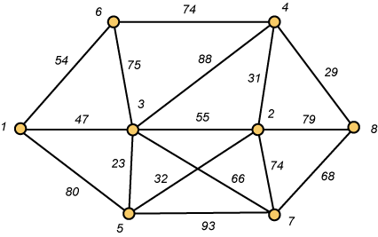
Minimum Weight Spanning Trees
Problem: Given a connected graph with non-negative weights on the edges, find a spanning tree T for which the sum of the weights on the edges in T is as small as possible.

Slide 54
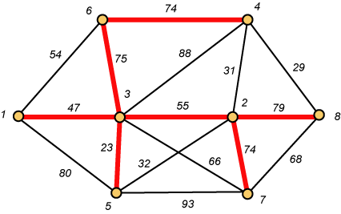
Links Will Form a Spanning Tree
Cost (T) = 47 + 23 + 75 + 74 + 55 + 74 + 79
= 427

Slide 55
Why Not Try All Possibilities?
Suppose the graph has n vertices. Then the number of possible spanning trees can be as large as n ^{n-2}.
When n = 75, this means that the number of spanning trees can be as large as
7576562804644601479086318651590413464814067\
83308840339247043281018024279971356804708193\
5219466686248779296875

Slide 56
Kruskal’s Algorithm (Avoid Cycles)
Sort the edges by weight
Build a spanning forest (that eventually becomes a tree) by adding the edge of minimum weight which when added to those already chosen does not form a cycle.

Slide 57
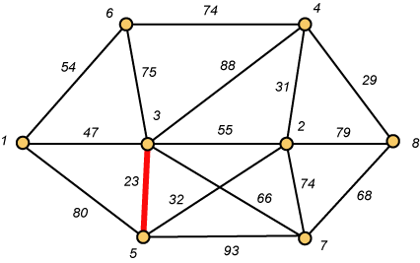
Kruskal – Step 1

Slide 58
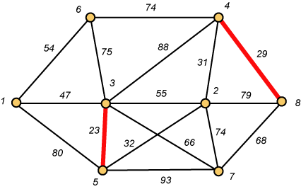
Kruskal – Step 2

Slide 59
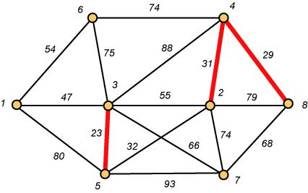
Kruskal – Step 3

Slide 60
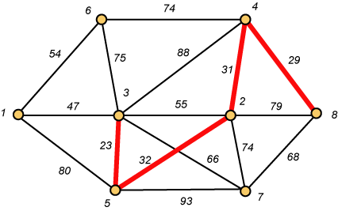
Kruskal – Step 4

Slide 61
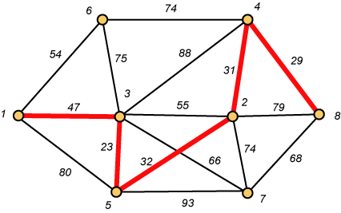
Kruskal – Step 5

Slide 62
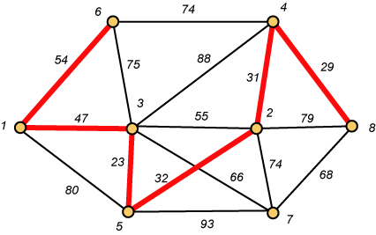
Kruskal – Step 6

Slide 63
Why Avoiding Cycles Matters
Up to this point, we have simply taken the edges in order of their weight. But now we will have to reject an edge since it forms a cycle when added to those already chosen.

Slide 64
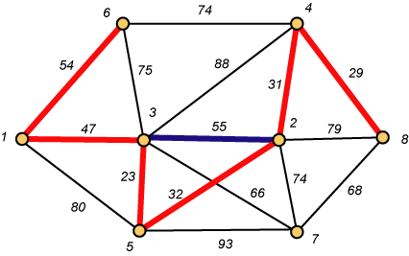
Forms a Cycle
So we cannot take the blue edge having weight 55.

Slide 65
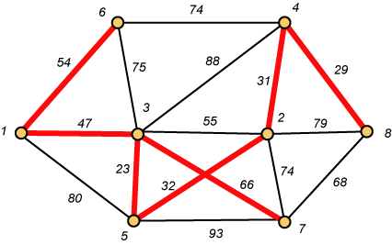
Kruskal – Step 7 DONE!!
Weight (T) = 23 + 29 + 31 + 32 + 47 + 54 + 66 = 282

